Slide 1
Data Screening

Slide 2
Data Screening
So, I’ve got all this data…what now?

Slide 3
Why?
Data screening – important to check for errors, assumptions, and outliers.
What’s the most important?
Depends on the type of test because they have different assumptions.

Slide 4
The List – In Order
Accuracy
Missing Data
Outliers
It Depends:
Correlations
Normality
Linearity
Homogeneity
Homoscedasticity

Slide 5
The List – In Order
Why this order?
Because if you fix something (accuracy)
Or replace missing data
Or take out outliers
ALL THE REST OF THE ANALYSES CHANGE.

Slide 6
Accuracy
Check for typos
Frequencies – you can see if there are numbers that shouldn’t be in your data set
Check:
Min
Max
Means
SD
Missing values

Slide 7
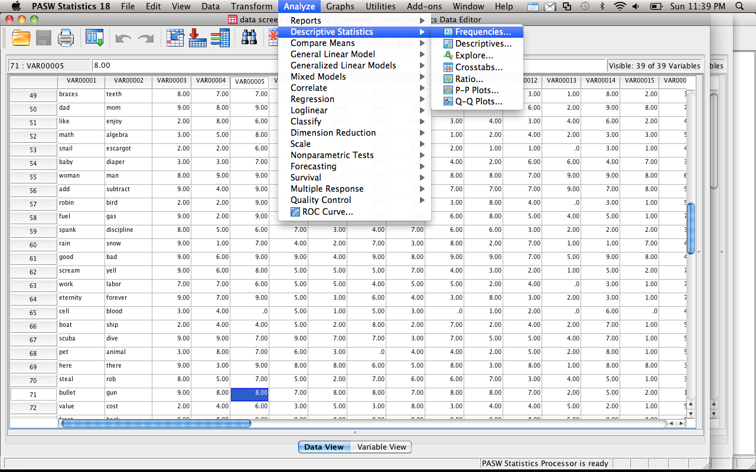
Accuracy

Slide 8
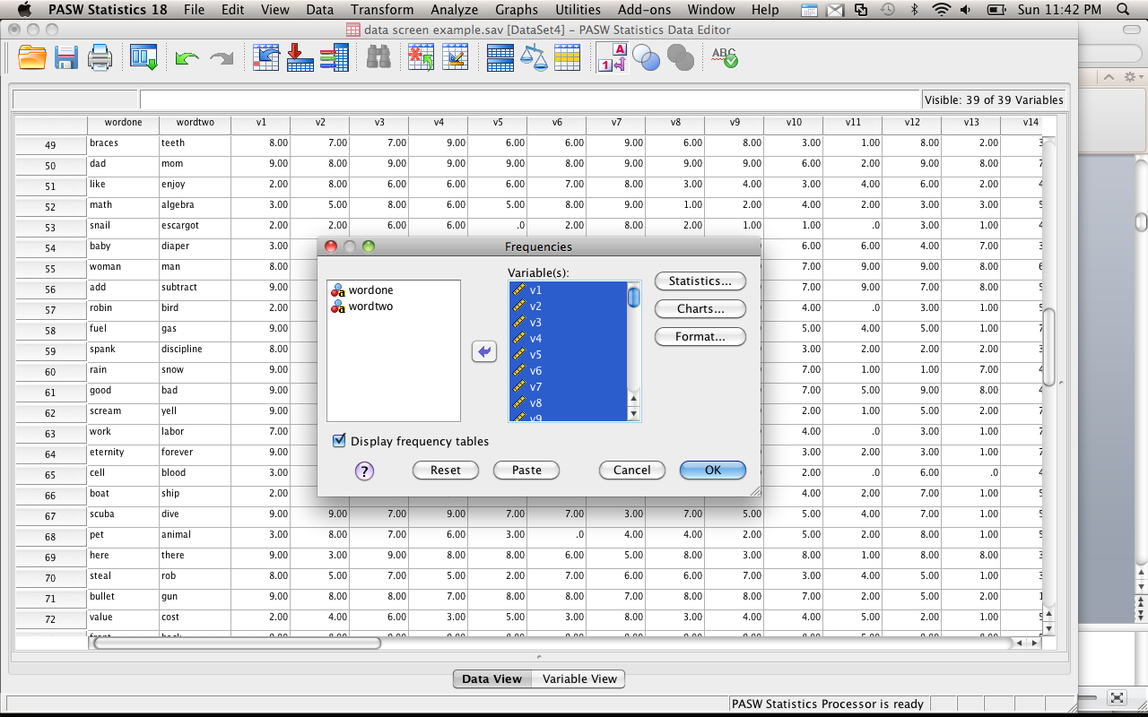

Slide 9
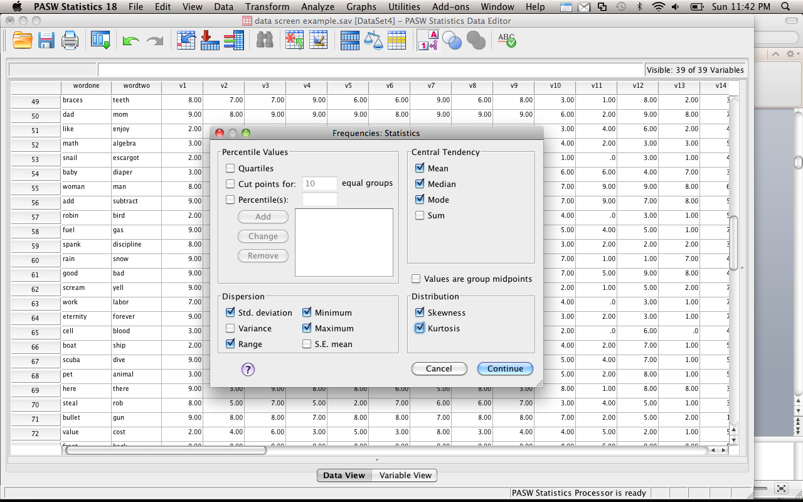

Slide 10
Accuracy
Interpret the output:
Check for high and low values in minimum and maximum
(You can also see the missing data).
Are the standard deviations really high?
Are the means strange looking?
This output will also give you a zillion charts – great for examining Likert scale data to see if you have all ceiling or floor effects.

Slide 11
Missing Data
With the output you already have you can see if you have missing data in the variables.
Go to the main box that is first shown in the data.
See the line that says missing?
Check it out!

Slide 12
Missing Data
Missing data is an important problem.
First, ask yourself, “why is this data missing?”
Because you forgot to enter it?
Because there’s a typo?
Because people skipped one question? Or the whole end of the scale?

Slide 13
Missing Data
Two Types of Missing Data:
MCAR – missing completely at random (you want this)
MNAR – missing not at random (eek!)
There are ways to test for the type, but usually you can see it
Randomly missing data appears all across your dataset.
If everyone missed question 7 – that’s not random.

Slide 14
Missing Data
MCAR – probably caused by skipping a question or missing a trial.
MNAR – may be the question that’s causing a problem.
For instance, what if you surveyed campus about alcohol abuse? What does it mean if everyone skips the same question?

Slide 15
Missing Data
How much can I have?
Depends on your sample size – in large datasets <5% is ok.
Small samples = you may need to collect more data.
Please note: there is a difference between “missing data” and “did not finish the experiment”.

Slide 16
Missing Data
How do I check if it’s going to be a big deal?
Frequencies – you can see which variables have the missing data.
Sample test – you can code people into two groups. Test the people with missing data against those who don’t have missing data.
Regular analysis – you can also try dropping the people with missing data and see if you get the same results as your regular analysis with the missing data.

Slide 17
Missing Data
Deleting people / variables
You can exclude people “pairwise” or “listwise”
Pairwise – only excludes people when they have missing values for that analysis
Listwise – excludes them for all analyses
Variables – if it’s just an extraneous variable (like GPA) you can just delete the variable

Slide 18
Missing Data
What if you don’t want to delete people (using special people or can’t get others)?
Several estimation methods to “fill in” missing data

Slide 19
Missing Data
Prior knowledge – if there is an obvious value for missing data
Such as the median income when people don’t list it
You have been working in the field for a while
Small number of missing cases

Slide 20
Missing Data
Mean substitution – fairly popular way to enter missing data
Conservative – doesn’t change the mean values used to find significant differences
Does change the variance, which may cause significance tests to change with a lot of missing data
SPSS will do this substitution with the grand mean

Slide 21
Missing Data
Regression – uses the data given and estimates the missing values
This analysis is becoming more popular since a computer will do it for you.
More theoretically driven than mean substitution
Reduces variance

Slide 22
Missing Data
Expected maximization – now considered the best at replacing missing data
Creates an expected values set for each missing point
Using matrix algebra, the program estimates the probably of each value and picks the highest one

Slide 23
Missing Data
Multiple Imputation – for dichotomous variables, uses log regression similar to regular regression to predict which category a case should go into

Slide 24
Missing Data
DO NOT mean replace categorical variables
You can’t be 1.5 gender.
So, either leave them out OR pairwise eliminate them (aka eliminate only for the analysis they are used in).
Continuous variables – mean replace, linear trend, etc.
Or leave them out.

Slide 25
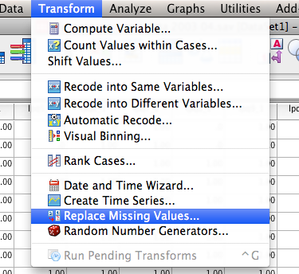

Slide 26
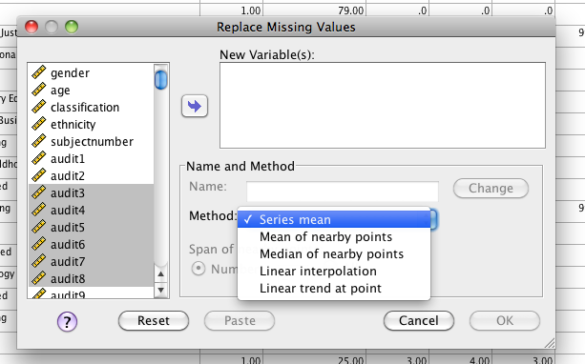

Slide 27
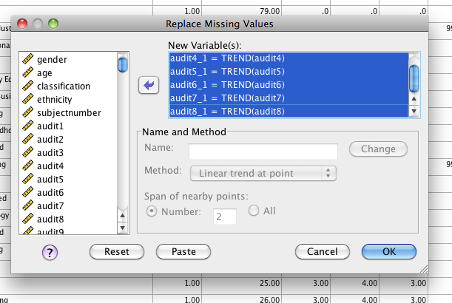

Slide 28
Outliers
Outlier – case with extreme value on one variable or multiple variables
Why?
Data input error
Missing values as “9999”
Not a population you meant to sample
From the population but has really long tails and very extreme values

Slide 29
Outliers
Outliers – Two Types
Univariate – for basic univariate statistics
Use these when you have ONE DV or Y variable.
Multivariate – for some univariate statistics and all multivariate statistics
Use these when you have multiple continuous variables or lots of DVs.

Slide 30
Outliers
Univariate
In a normal z-distribution anyone who has a z-score of +/- 3 is less than 2% of the population.
Therefore, we want to eliminate people who’s scores are SO far away from the mean that they are very strange.

Slide 31
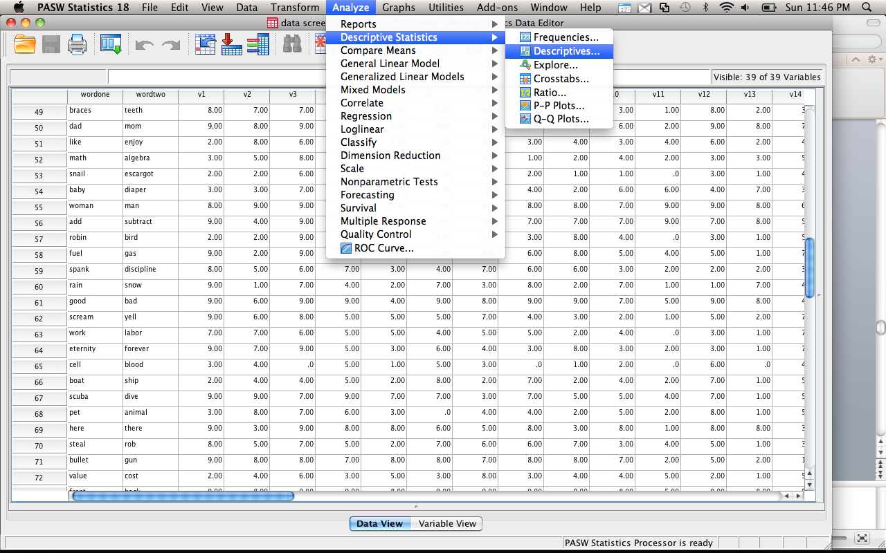
Outliers
Univariate

Slide 32
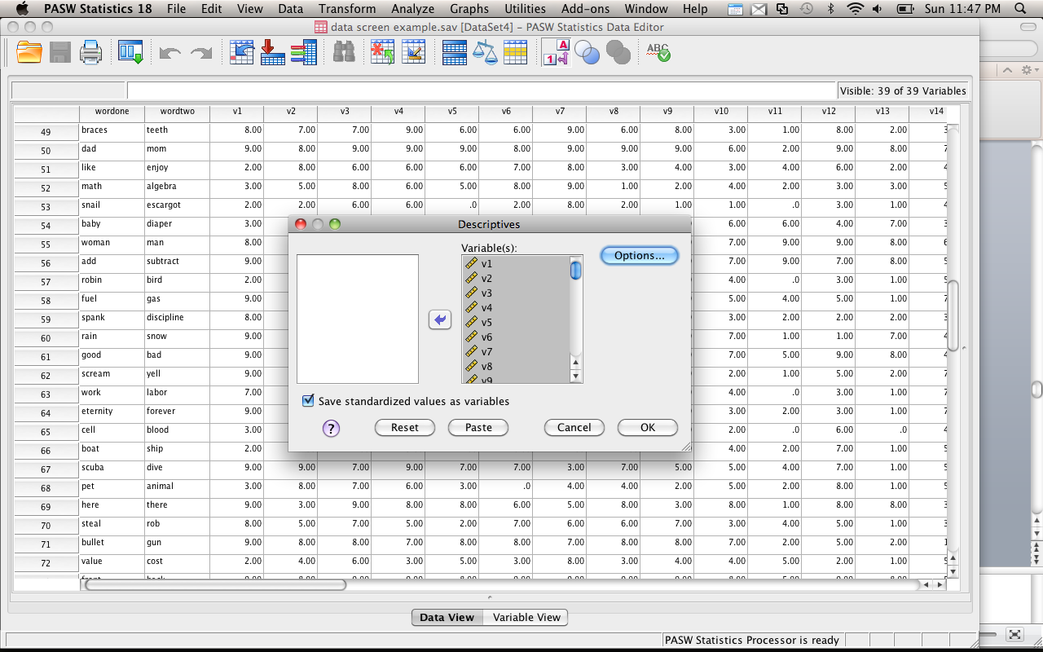

Slide 33
Outliers
Univariate
Now you can scroll through and find all the |3| scores
OR
Rerun your frequency analysis on the Z-scored data.
Now you can see which variables have a min/max of |3|, which will tell you which ones to look at.

Slide 34
Outliers
Multivariate
Now we need some way to measure distance from the mean (because Z-scores are the distance from the mean), but the mean of means (or all the means at once!)
Mahalanobis distance
Creates a distance from the centroid (mean of means)

Slide 35
Outliers
Multivariate
Centroid is created by plotting the 3D picture of the means of all the means and measuring the distance
Similar to Euclidean distance
No set cut off rule ☹
Use a chi-square table.
DF = # of variables (DVs, variables that you used to calculate Mahalanobis)
Use p<.001

Slide 36
Outliers
The following steps will actually give you many of the “it depends” output.
You will only check them AFTER you decide what to do about outliers.
So you may have to run this twice.
Don’t delete outliers twice!

Slide 37
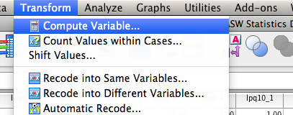

Slide 38
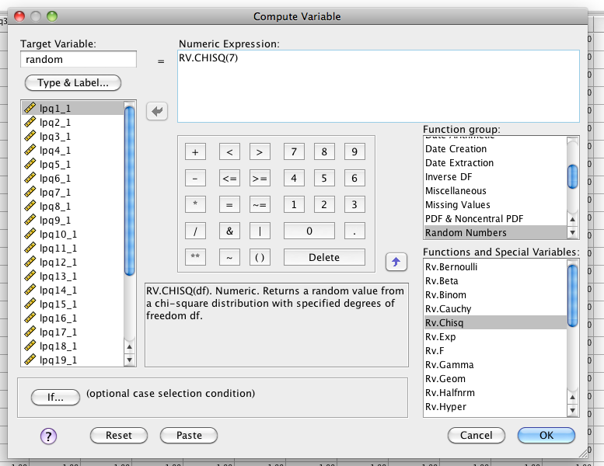

Slide 39
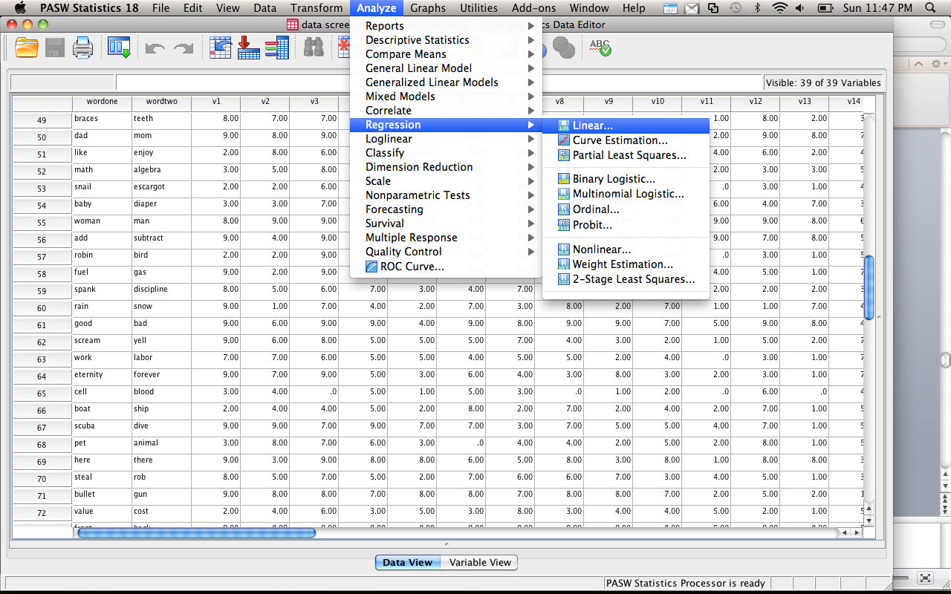

Slide 40
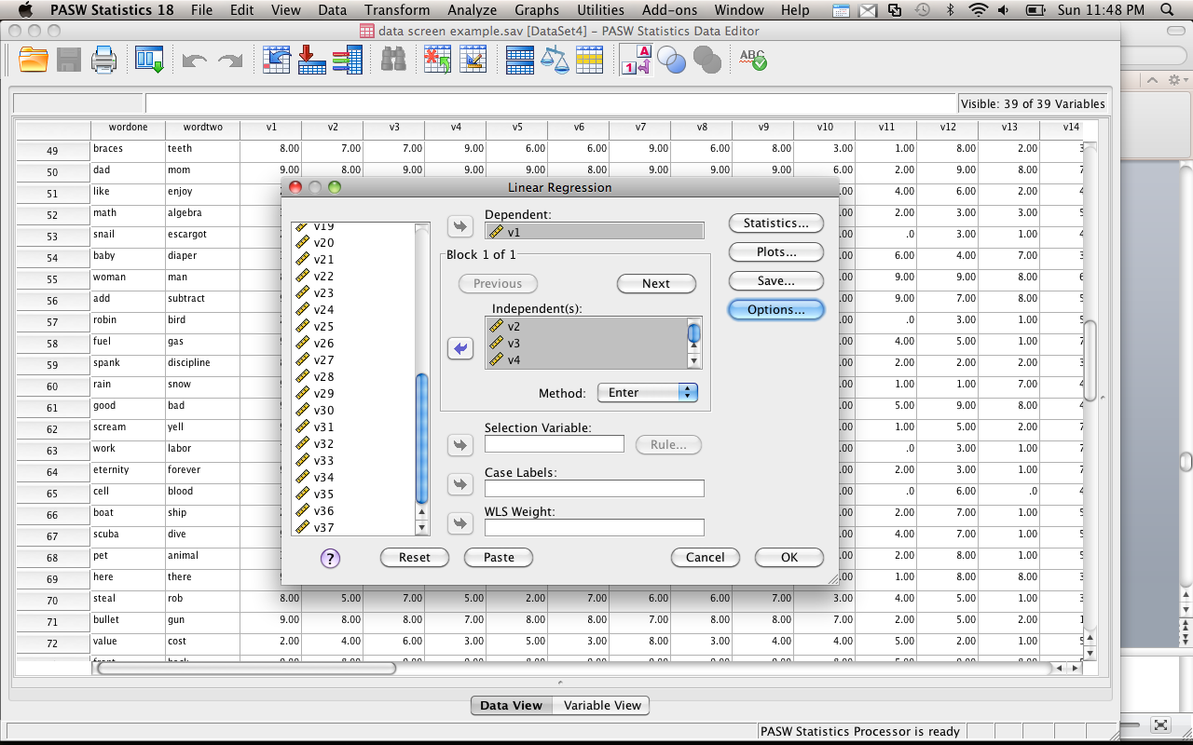

Slide 41
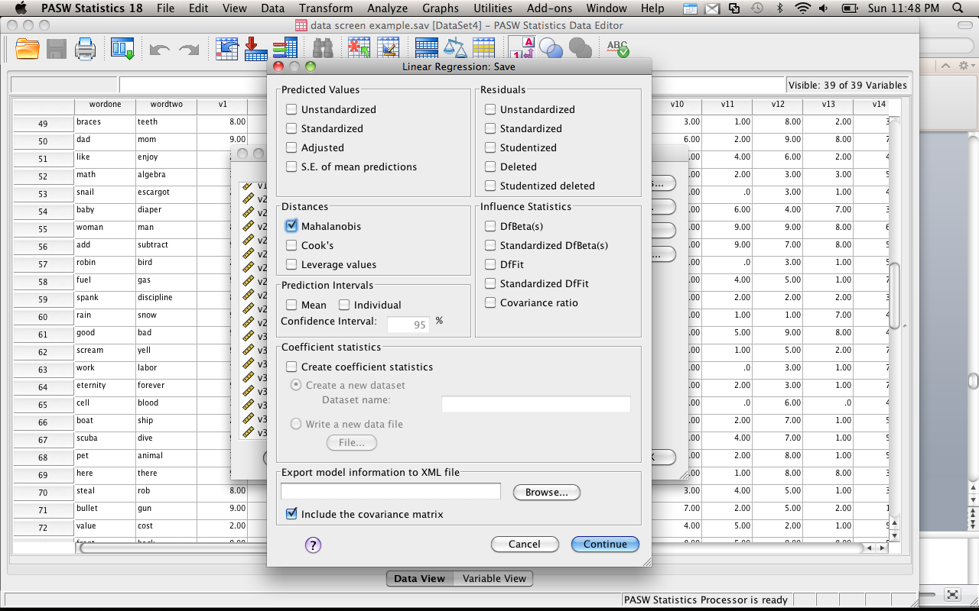

Slide 42
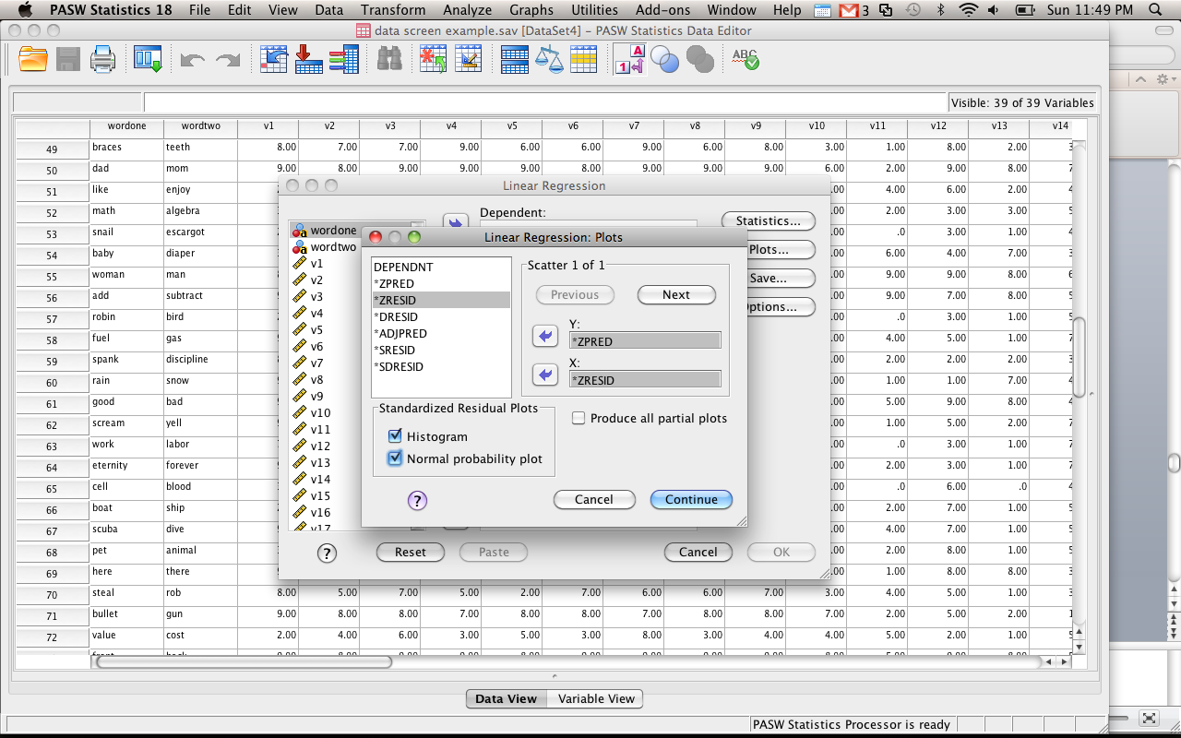

Slide 43
Outliers
Go to the Mahalanobis variable (last new variable on the right)
Right click on the column
Sort DESCENDING
Look for scores that are past your cut off score

Slide 44
Outliers
So do I delete them?
Yes: they are far away from the middle!
No: they may not affect your analysis!
It depends: I need the sample size!
SO?!
Try it with and without them. See what happens. FISH!

Slide 45
Correlation
This analysis will only be necessary if you have multiple variables
Regression, multivariate statistics, repeated measures, etc.
You want to make sure that your variables aren’t so correlated the math explodes.

Slide 46
Correlation
Multicollinearity = r > .90
Singularity = r > .95
SPSS will give you a “matrix is singular” error when you have variables that are too highly correlated
Or “hessian matrix not definite”

Slide 47
Correlation
Run a bivariate correlation on all the variables
Look at the scores, see if they are too high
If so:
Combine them (average, total)
Use one of them
Basically, you do not want to use the same variable twice → reduces power and interpretability

Slide 48
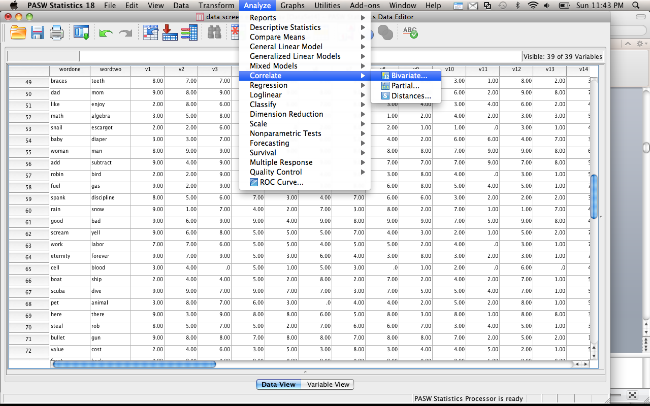

Slide 49
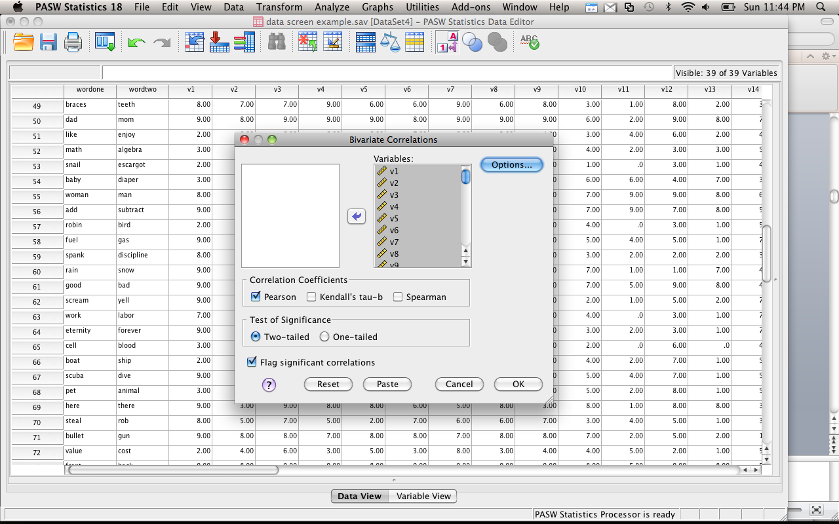

Slide 50
Normality
This assumption is implied for nearly everything we are going to cover in this course.
Parametric statistics (the things you know: ANOVA, MANOVA, t-tests, z-scores, etc.) – require that the underlying distribution is normal.
Why?

Slide 51
Normality
However, it’s hard to know if that’s true. So you can check if the data you have is normal.
OR You can make sure you have the magical statistical number N = 30.
Why?

Slide 52
Normality
Nonparametric statistics (chi-square, log regression) do NOT require this assumption, so you don’t have to check.

Slide 53
Normality
Univariate
Check by looking at your skew and kurtosis values.
You want them to be < |3| - same idea as z-scores.

Slide 54
Normality
Skewness – symmetry of a distribution
Skewed – mean not in the middle
Kurtosis – peakedness of a distribution
Tall and skinny or fat and short
SPSS
Frequencies will give you values for testing (see analysis we did earlier).
Remember – if you changed something (deleted, whatever) you need to rerun those numbers!

Slide 55
Normality
Multivariate – all the linear combinations of the variables need to be normal
Use this version when you have more than one variable
Basically if you ran the Mahalanobis analysis – you want to analyze multivariate normality.

Slide 56
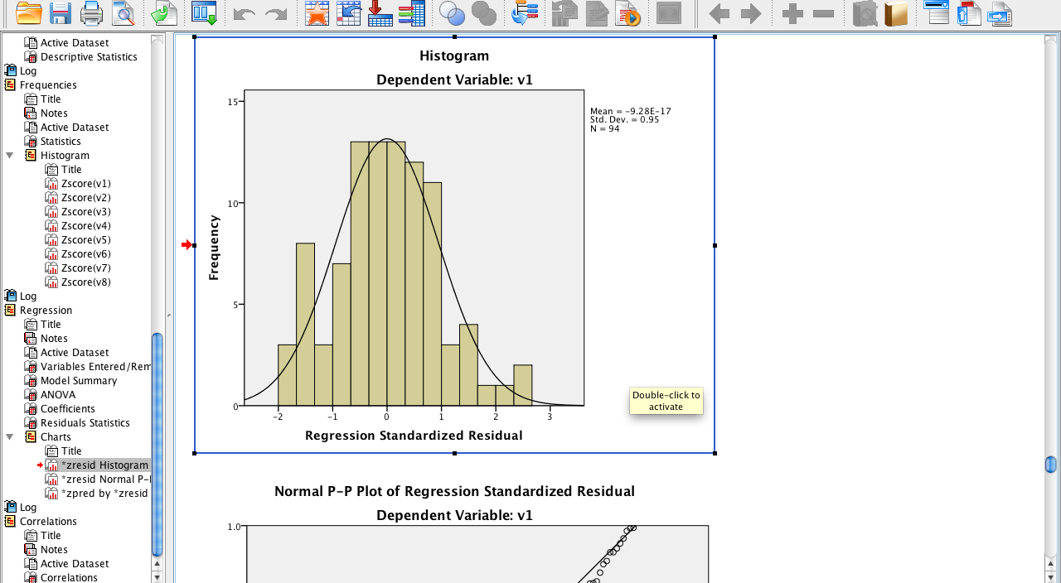

Slide 57
Linearity
Assumption that the relationship between variables is linear (and not curved).
Most parametric statistics have this assumption (ANOVAs, Regression, etc.).

Slide 58
Linearity
Univariate
You can create bivariate scatter plots and make sure you don’t see curved lines or rainbows.

Slide 59
Linearity
Talk about chart builder here.

Slide 60
Linearity
Multivariate – all the combinations of the variables are linear (especially important for multiple regression and MANOVA)
Use the output from your fake regression for Mahalanobis.

Slide 61
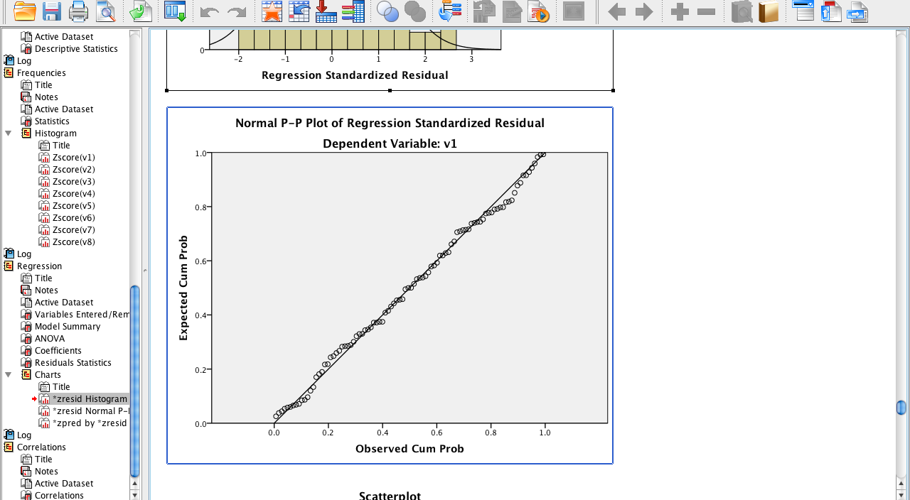

Slide 62
Homogeneity
Assumption that the variances of the variables are roughly equal.
Ways to check – you do NOT want p < .001:
Levene’s - Univariate
Box’s – Multivariate
You can also check a residual plot (this will give you both uni/multivariate)

Slide 63
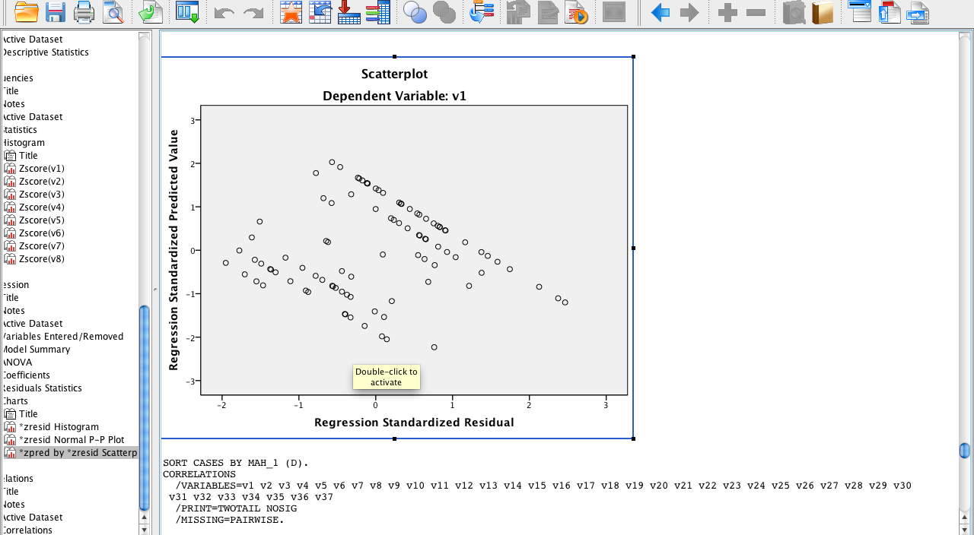

Slide 64
Homogeneity
Spherecity – the assumption that the time measurements in repeated measures have approximately the same variance
Difficult assumption…

Slide 65
Homoscedasticity
Spread of the variance of a variable is the same across all values of the other variable
Can’t look like a snake ate something or megaphones.
Best way to check is by looking at scatterplots.

